Slide 1


GOMYCODE
Checkpoint number 26 : Introduction to Databases
d
SQL VS
No SQL
Realized by : Asma KHARROUBI
Instructor : Mr. Fedi Touzri
08-02-2023

Slide 2

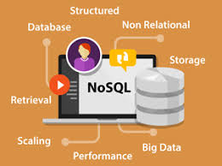
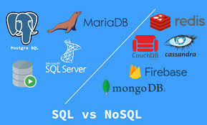
Introduction
Structured Query Language SQL is a standard language used for storing , manipulating and retrieving data from relational databases management system (RDBMS).
No Structured Query Language Not Only SQL is a database provides a mechanism for storage and rertrieval of data that is modeled in means other than the tabular relations used in relational databases.
SQL and NoSQL are two different approaches to data management
and represent two distinct categories of databases.
01

Slide 3
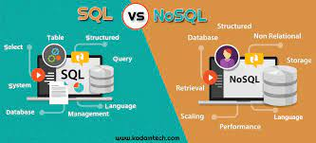
SQL VS NoSQL
SQL databases are also known as Relational Databases and are based on a relational model. In a relational database, data is stored in tables, with each table having a unique identifier
(Primary Key) and relationships
defined between tables using
Foreign Keys.
SQL databases are well suited for
structured data and are ideal for use cases where transactional consistency is a priority, such as financial applications.
On the other hand, NoSQL databases do not follow the relational model and offer more flexibility in terms of data storage.
  NoSQL databases are designed to handle large amounts of unstructured or semi-structured data, and are better suited for use cases where scalability and performance are the main priorities.
NoSQL databases can handle diverse data types, including documents, key-value pairs, and graph data, and can be easily scaled horizontally.
02

Slide 4
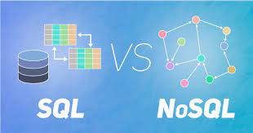
MySQL
NoSQL
Nature
Relational database
Non-Relational database
Design
Based on the concept of tables
Based on the concept of documents
Scalable
Tough to scale due to its relational nature
Easily scalable big data compared to relational
Model
Detailled database model is needded before creation
No need of a detailled database model
Community is growing rapidly, but still smaller compared to MySQL
Community
Vast community available
Standardization
SQL is a standard language
Lacks standard query language
Schema
The schema is rigid
The schema is dynamic
Flexibility
Not very flexibale in iterms of design
Very flexibale in iterms of design
No effect on the design with insertion of new columns or fields
Insertions
Inserting new columns or fields affect the design
03

Slide 5

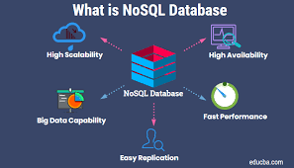


Use Case
Use Case
Legacy applications or applications that require multi-row transactions
Real-time analytics , content management, IOT, mobile applications
Data structure
Data structure
Structured data with clear schema
No schema definition required
Risk
Risk of SQL injection attacks
Risk
Analysis
Less risk of attack due to design
MySQL is perfect when your data is structured
and you are in need of a traditional relationship database
Analysis
MongoDB works great for unstructured data and lends you opportunity for growth
04

Slide 6
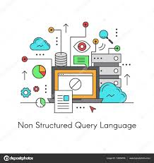

Conclusion
SQL and NoSQL databases have different design goals and trade-offs, and the choice between the two will depend on the specific requirements of the use case. While SQL databases are best suited for structured data and transactional consistency, NoSQL databases are better suited for handling large amounts of unstructured or semi-structured data, and can be easily scaled.
05

